Slide 1
Spring 2017 Midterm Progress Report
Group 65: Jiongcheng Luo, Drew Hamm, Krisna Irawan
Notes:
Hi, I’m ….i’m …, We are group nubmer 65 of CS captone project.
Or project is Head-up Display System sponsored by Rockwell Collins.
Today, we will be presenting our senior project midterm progress report for srping 2017.

Slide 2


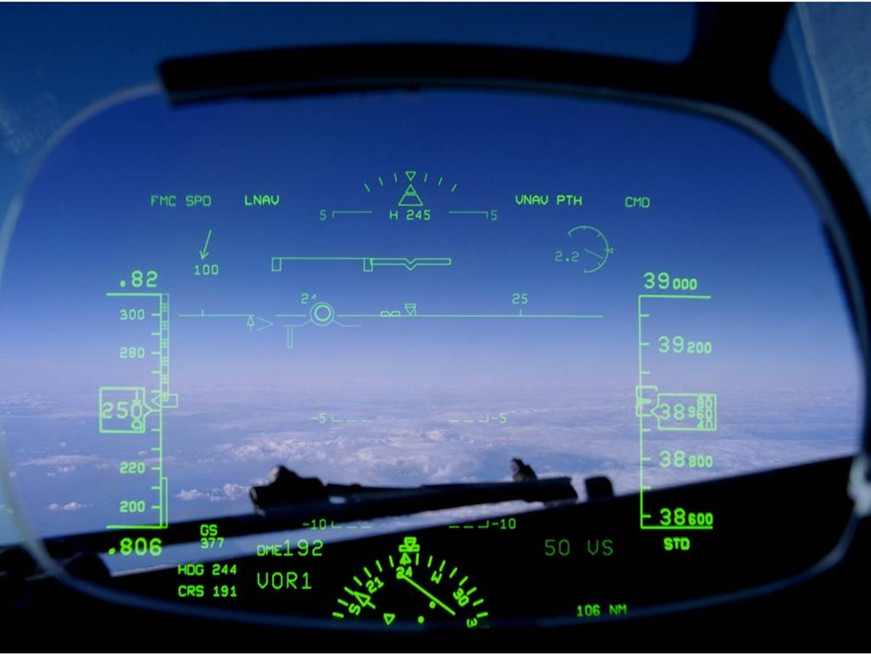

Elevator Pitch

Slide 3
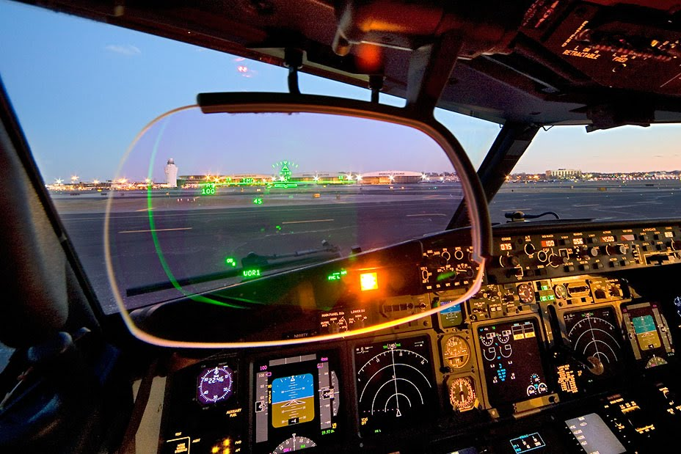

Head-UP Display auto-alignment system
Notes:
Now, lets briefly recap what our project is and what we are working on.
A Head-Up display (HUD) is a transparent display that is installed in an aircraft today, that located in the pilot’s forward field of view, a HUD presents flight information by using graphical, numerical and symbolical data. This device eliminates the need for pilots to continually transition from head-down instruments to head-up, out-the-window view during critical phases of flight. Currently, a HUD obtains data from an aircraft’s Inertial Measurement Unit (IMU). To display precise and accurate information, the HUD must be carefully aligned to the IRU during installation. However, the current HUD installation process requires specialized equipment and epoxy which is time consuming, costly, and interrupts production line progress for the manufacturer. The goal of this project is to improve the current HUD alignment systems by reducing the installation cost and time required to precisely align flight information to the HUD. Our client, Rockwell Collins, seeks a new alignment methodology that utilizes HUD mounted inertial measurement units.

Slide 4
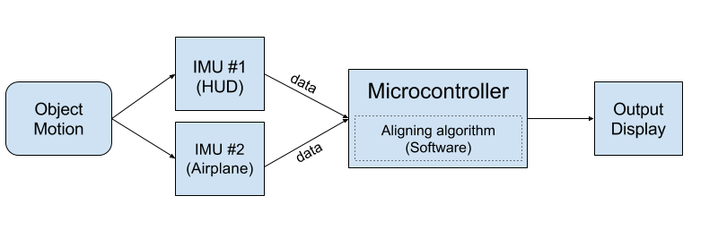
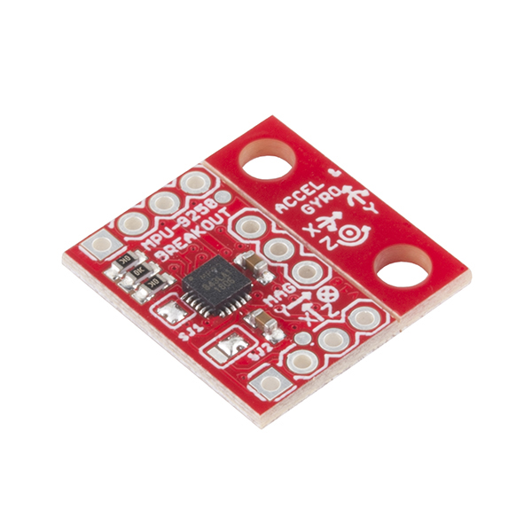
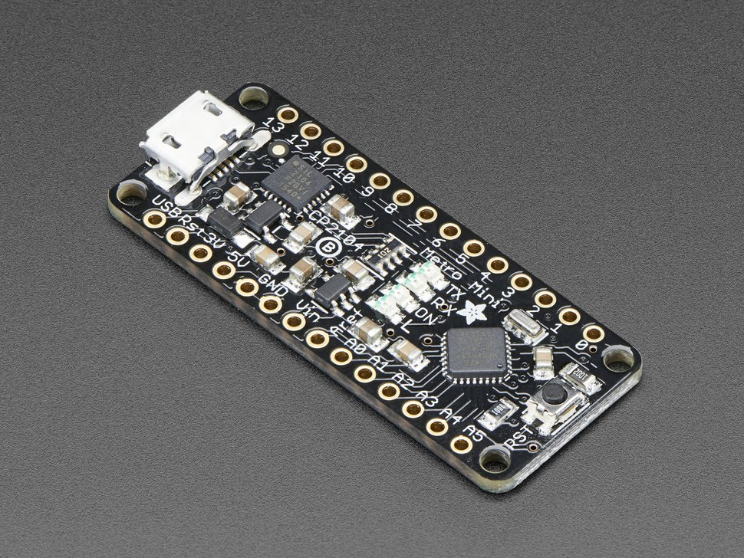
Project Recap
Notes:
This is a workflow of our entire project system, and basically this project can be viewed as three parts.
The configuration of hardware and communication between devices.
The development of an program that can find the HUD’s alignment offset in relation to the aircraft which is implemented on the microcontroller,
The design and implementation of a demonstration interface that visually presents the alignment results

Slide 5
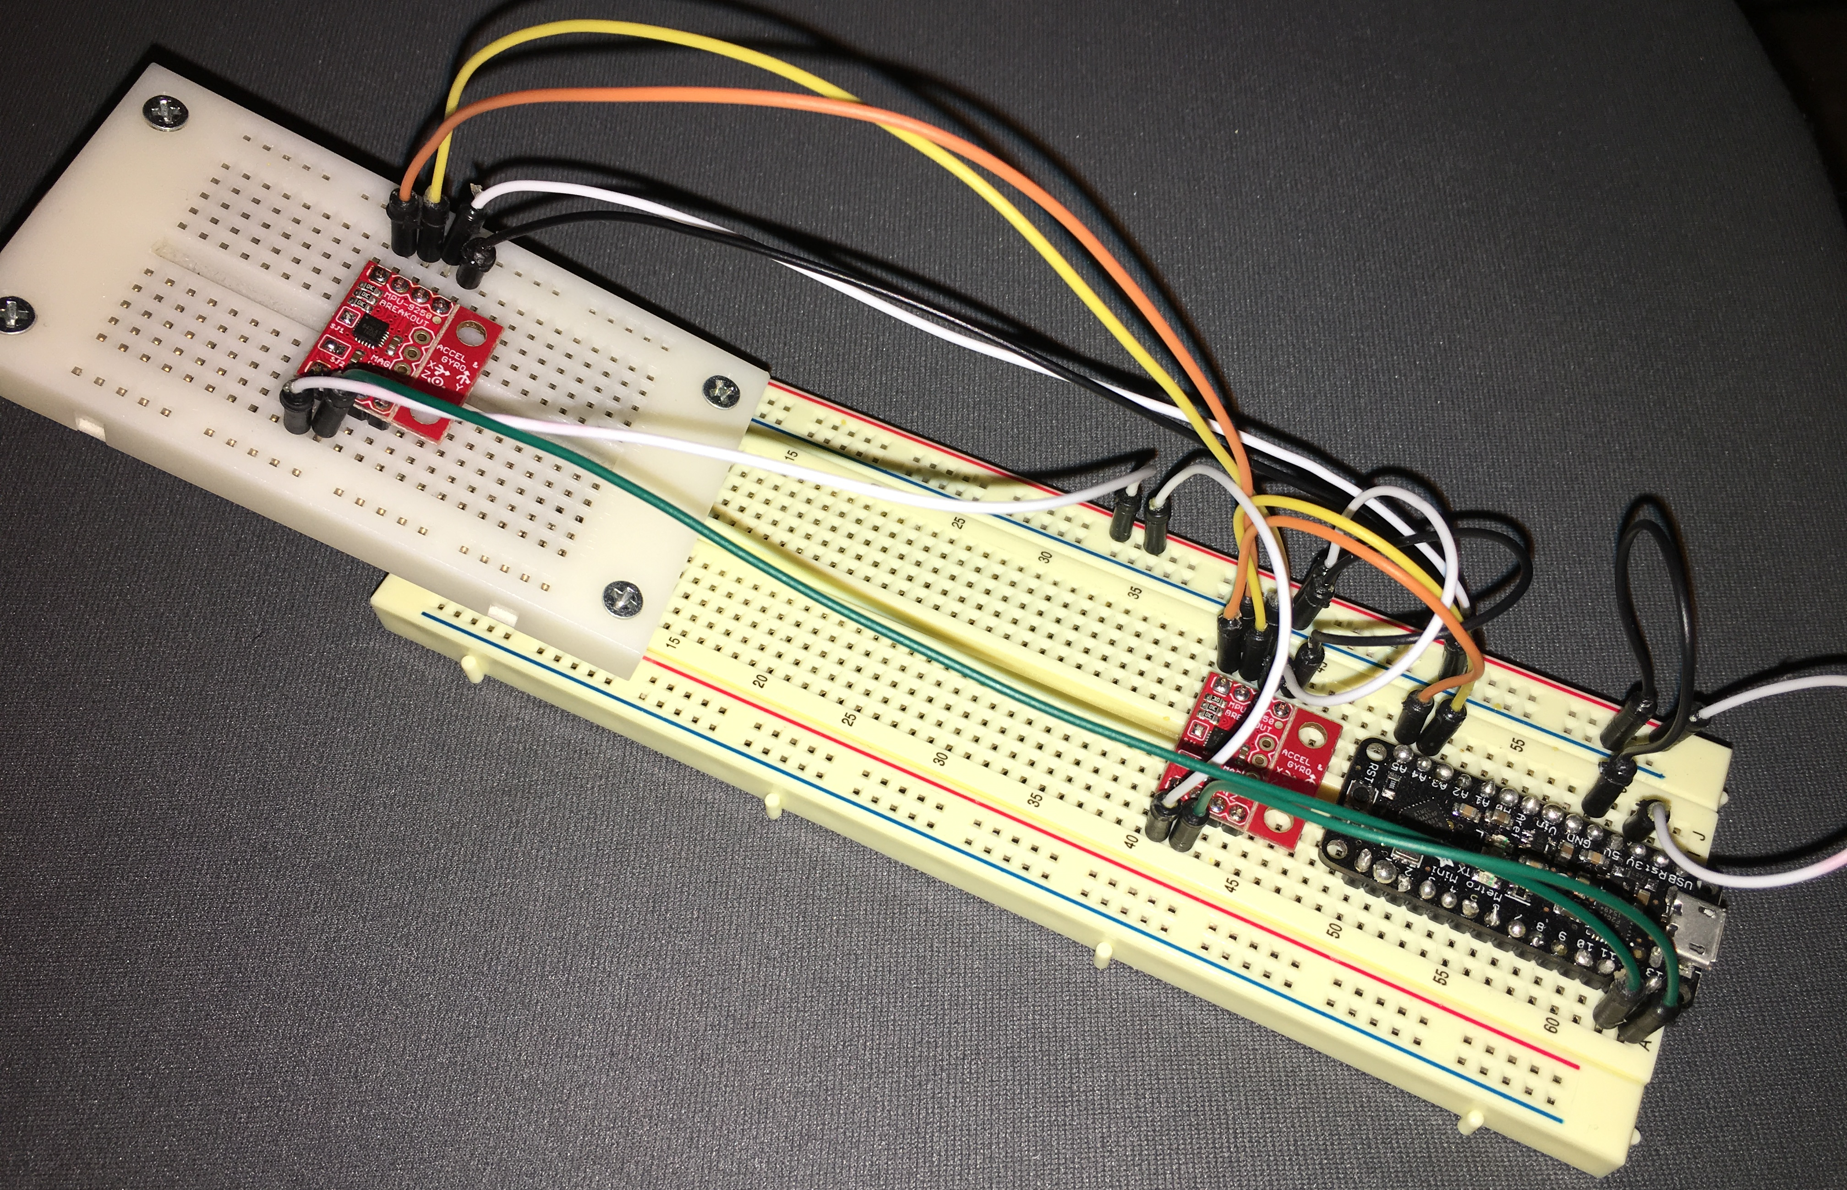
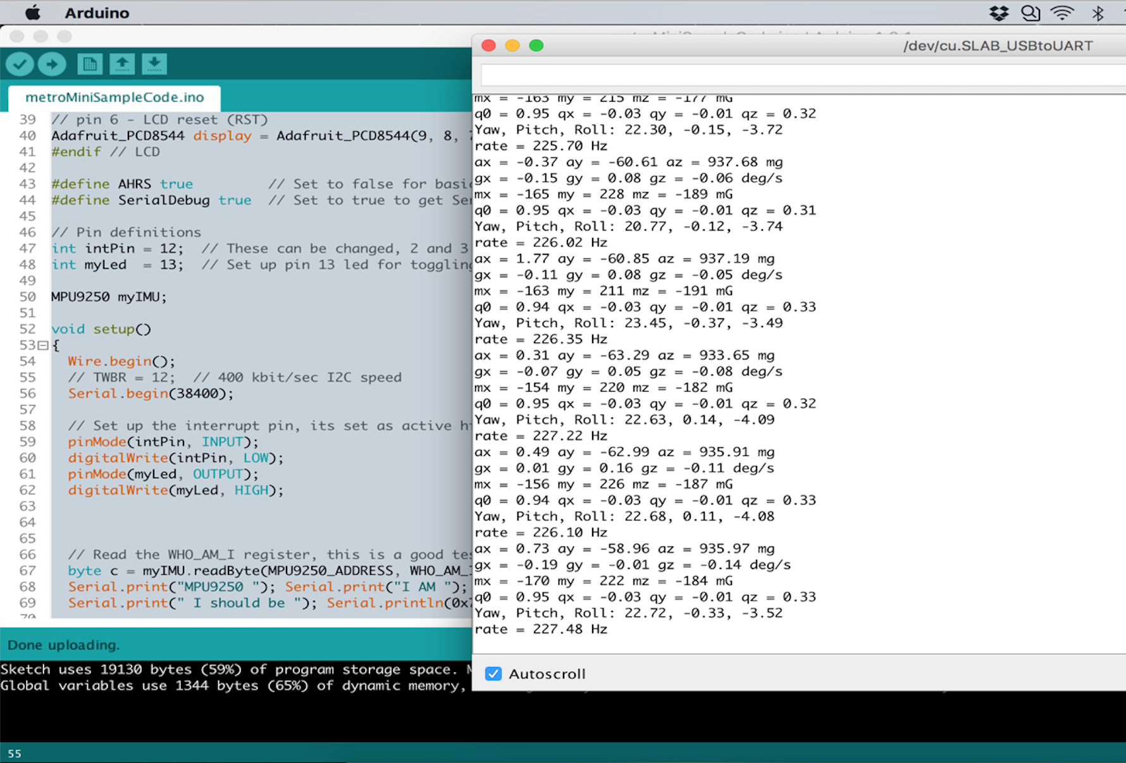
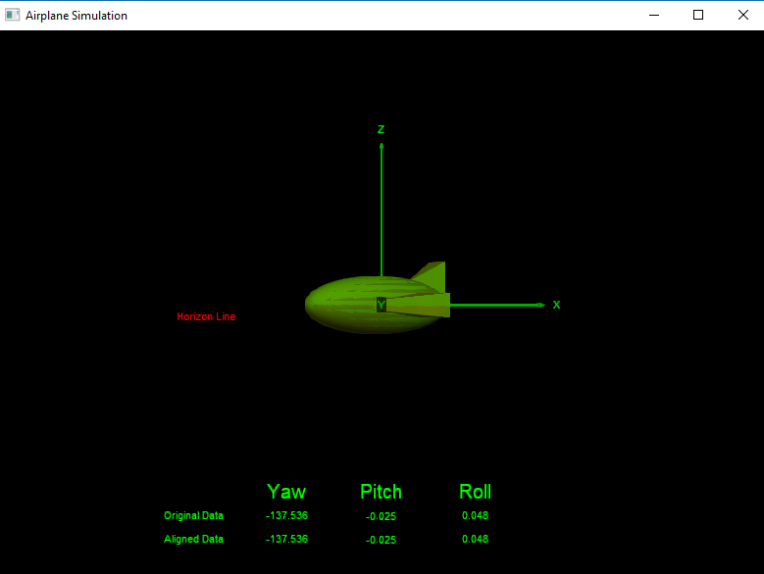
Current Stage & Remain
Hardware
Software
GUI
Notes:
At this moment, we have completed most required implementations from the perspectives of both hardware and software sides. Specifically, we have successfully configured the hardware setup for reading two sets of data reading from two separate IMUs, and we have found supported libraries to convert raw data from all three kinds of sensors (accelerometer, gyroscope and magnetometer) to our desired format (quaternions and yaw, pitch, roll) in order to implement the alignment process. Then we also designed and created a simple 3D graphical interface to visualize the real time motion of the the IMUs, and finally, we implemented an algorithm to calibrate and align between the output data from both IMUs. However, we are still on a stage of verifying and testing, we will still have further steps to take for accomplishment.
What we left for the project are mostly about the improvement including increasing the accuracy of reading data as well as the UI display, and we are also trying to solve the stretch goal of this project, which is to create the dynamic auto-alignment system algorithm.

Slide 6

Current Stage & Remaining Works
I have finished connecting the user interface with the Arduino portion of the project.
I have finished implementing the statistical analysis portion of the project to the Arduino code.
All of my requirement responsibility have been fulfilled.
Keep improving and keep working on the project just to see if we can also solve the stretch goal of this project
Source: http://www.kidsindustries.com/files/large/7e67fc67bcfd578da574731d43df9dd5.png

Slide 7
Improvements
I change the 2-D gauge like graphical user interface to a more robust 3-D simulation graphical user interface
I think it is better for demonstration and easier to visualize the change on the airplane

Slide 8
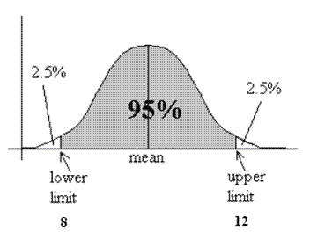
Statistical Analysis
Implemented in Arduino IDE
Taking 60 samples to find the confidence interval
The data that we get is stable and achieve the desired accuracy of within miliradians range
Source: https://i1.wp.com/cpmc.coriell.org/images/c_interval.gif

Slide 9
Statistical Analysis Code Review

Slide 10
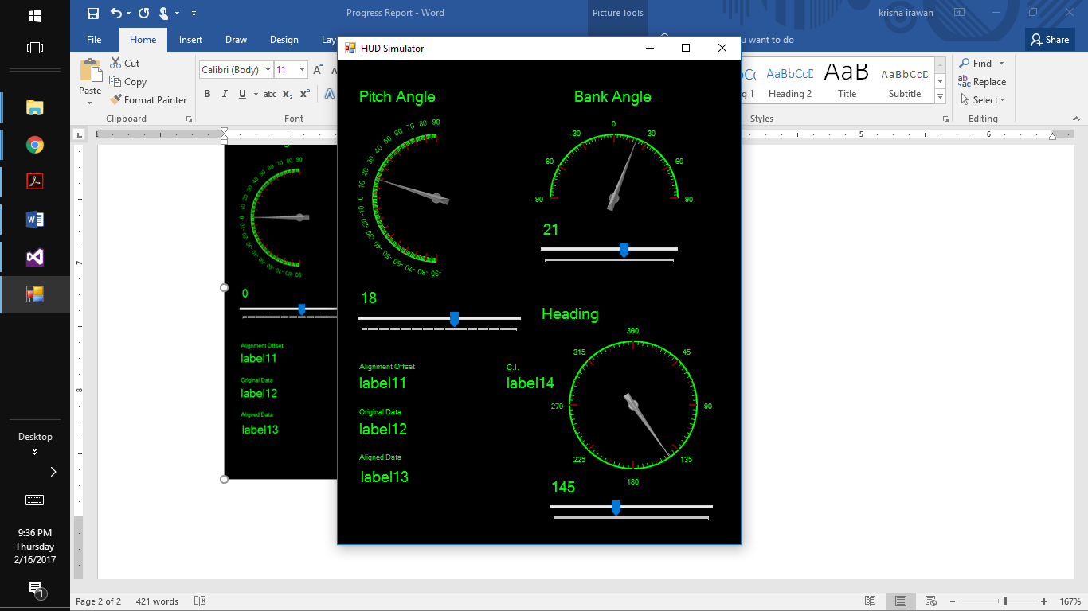
Graphical User Interface
Changed from Visual Studio Toolkit to Vpython library
Changed the GUI from 2-D gauge-like interface to a more compelling 3-D aircraft simulation
Better for demonstration and easier to visualize

Slide 11
Graphical User Interface Code Review

Slide 12
Demonstration of Graphical User Interface

Slide 13
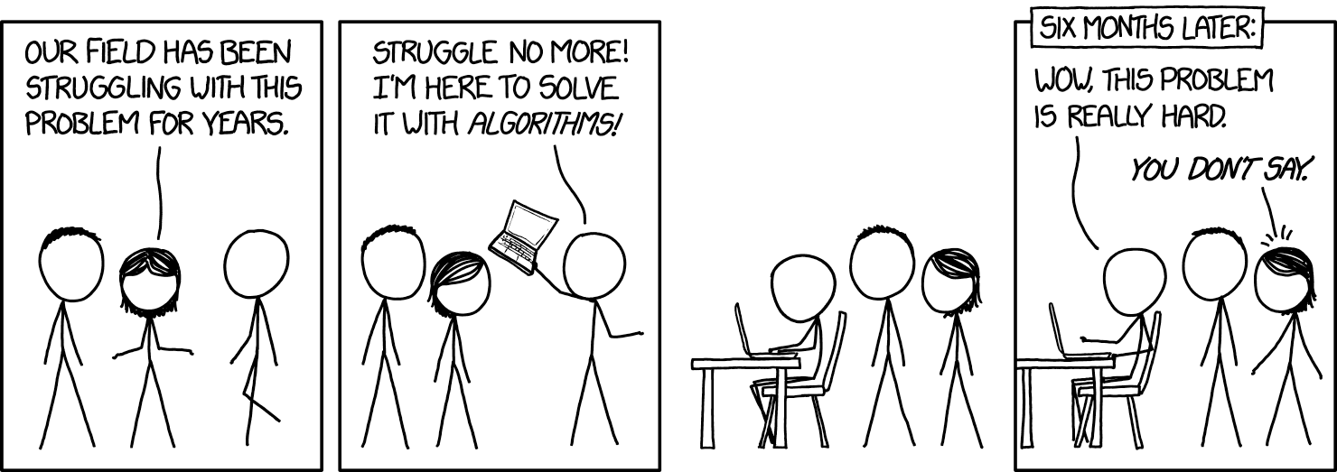
Current Stage & Remaining Works
Sensor data is being sent from each individual IMU to the Microcontroller via I2C then sent from Microcontroller to GUI via serial
We a using the Mahoney filter to convert sensor data to quaternion
We are taking the difference between each IMU
Accuracy improvements may still be made.
Source: https://xkcd.com/1831/

Slide 14
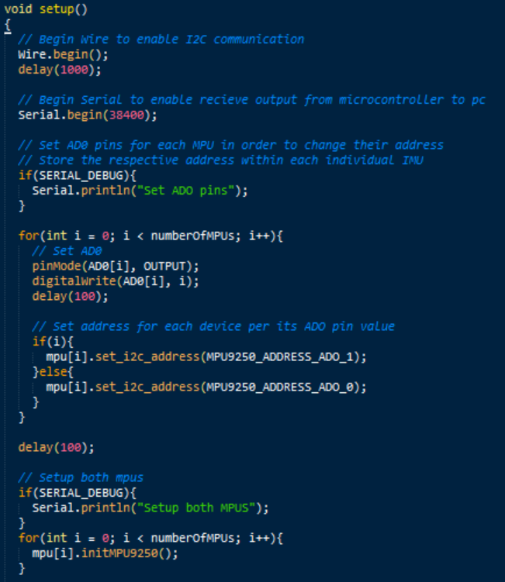
Enabling Communication via I2C and serial

Slide 15
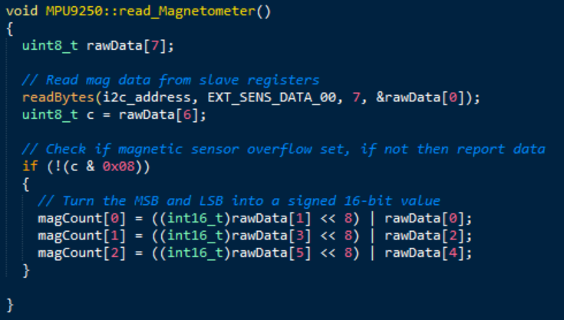
Enabling Communication via I2C and serial

Slide 16

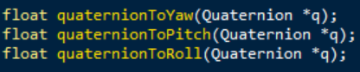
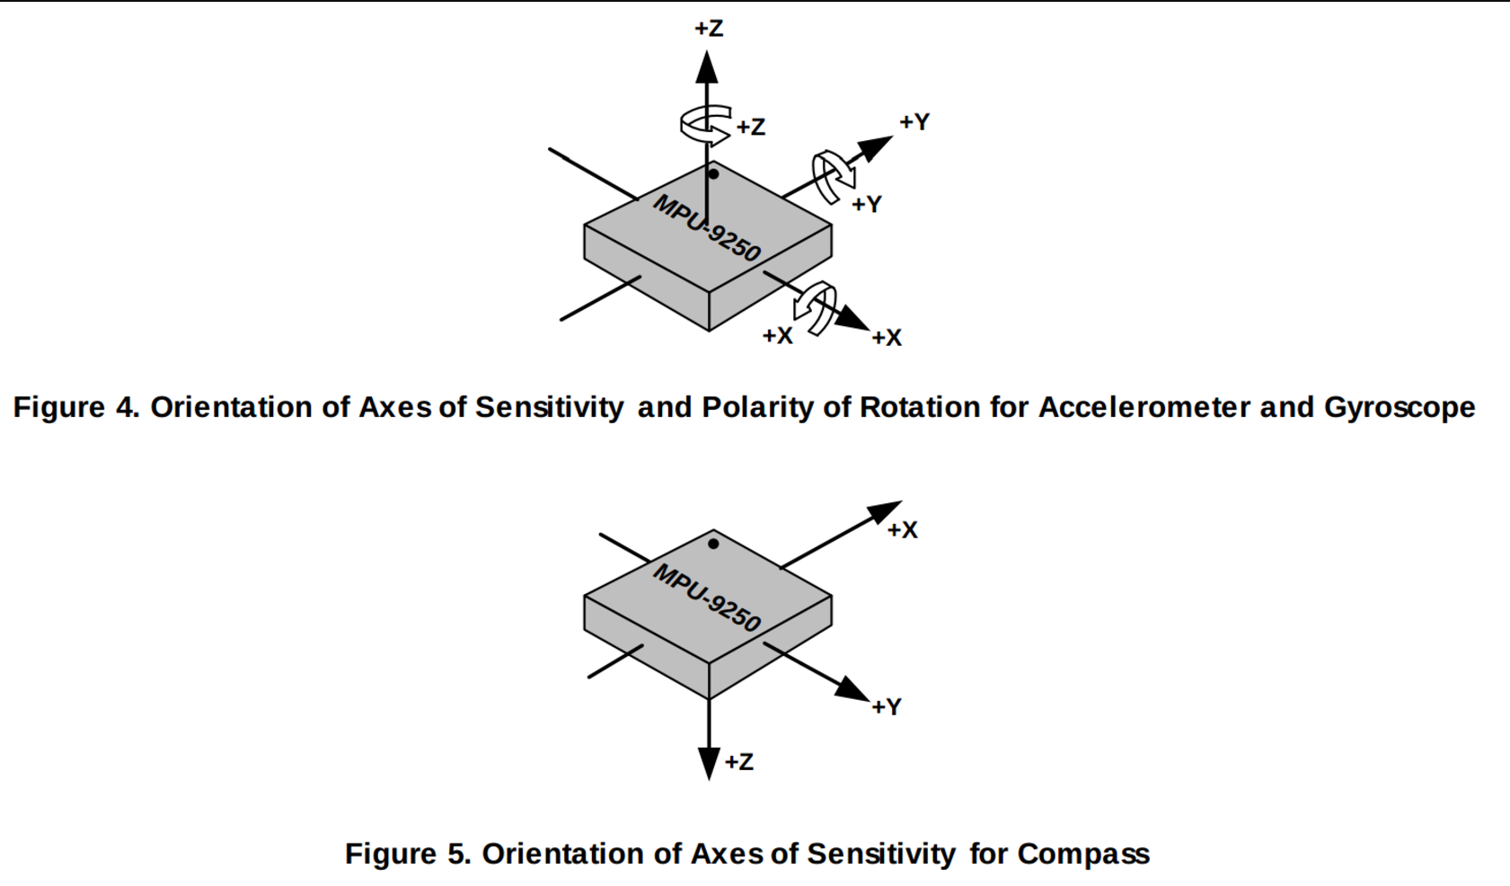
Using the Mahoney filter to convert sensor data to quaternion. Then to yaw, pitch and roll.
Source: http://www.lucidarme.me/wp-content/uploads/2015/01/AxisOrientation.png

Slide 17
Live demo on Arduino IDE

Slide 18
Thank you for listening!
Notes:
This is the end of the our Spring 2017 midterm progress presentation, thank….

